Slide 1
Activation Functions
By: Muhammad Mehmood Ahmed
Data Scientist

Slide 2
What is an Activation Function?
The activation function is the non linear transformation that we do over the input signal. This transformed output is then sent to the next layer of neurons as input

Slide 3
Can we do without an activation function?
Now the question which arises is that if the activation function increases the complexity so much, can we do without an activation function?
When we do not have the activation function the weights and bias would simply do a linear transformation.

Slide 4
A linear equation is simple to solve but is limited in its capacity to solve complex problems. A neural network without an activation function is essentially just a linear regression model.
The activation function does the non-linear transformation to the input making it capable to learn and perform more complex tasks.

Slide 5
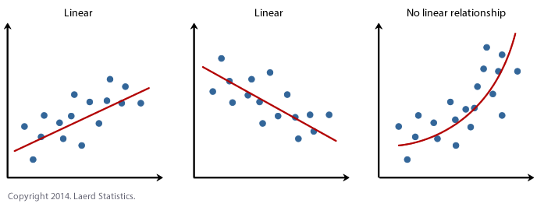

Slide 6
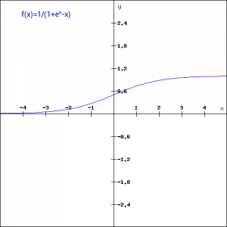
Types of activation functions
Sigmoid
f(x)=1/(1+exp(-x))

Slide 7
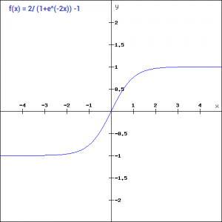
Tanh
tanh(x) = 2sigmoid(2x)-1 = 2/(1+exp(-2x)) -1

Slide 8
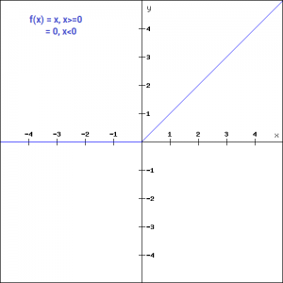
ReLU
f(x) = max(0,x)

Slide 9
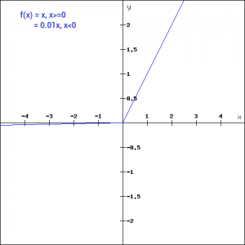
Leaky ReLU
f(x)= | ax with x<0
| x with x>=0

Slide 10
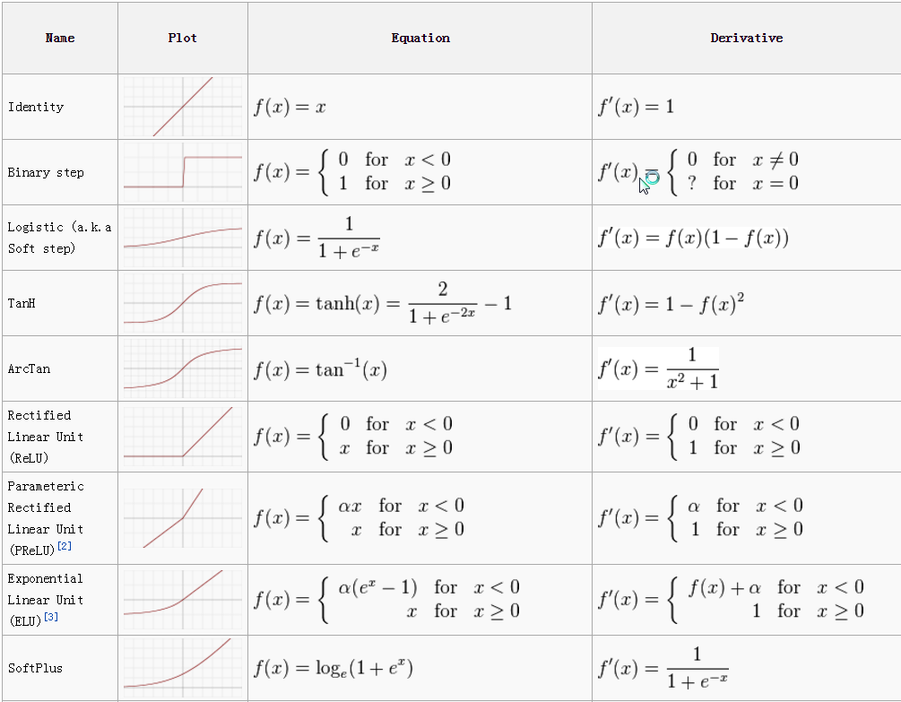

Slide 11
Your Task:
Find Pros and cons of Following Activation functions:
Sigmoid
Tanh
Relu
Leakly Relu
Soft max
What is the suitable layer or model to use each one?
Search About Types of Loss functions in neural network

